Slide 1
Bud Jaegar
- Drink your way, charge our way -
Minh Doan - Pauline Saintil - Prafull Pande - Xianya Zhong
Notes:
A client has this business
We are presenting to you angel investors about this business.

Slide 2
Table of Content
Marketing, Organization and HR analysis
Operational analysis
Financial analysis
Innovation and research analysis
Summarily evaluation
Overall Strategy & Implementation plan (6-months)
Conclusion and Decision
Q & A, references

Slide 3
Marketing Management - Marketing Mix
Target Demographic:
Ages Range: 35 - 49
Education: bachelor's degree or higher
Annual income: $75,000 and above
Product:
Bud Jaeger’s craft beer
16 ounces of brew
On tap, served in a pint glass
Seasonal Flavoring
Place:
East Cambridge Neighborhood, Cambridge Massachusetts
Average household income: $89,818 to $121,056
Population Demographics:
34% aged 25-34
14% aged 35-44
27.4% hold bachelor's degree
34.2% hold a master’s degree
14.6% hold a Doctoral degree
Promotion:
Social Media Marketing -i.e, Instagram Ads,Facebook Ads
Google Search -Paid Ads
Promotional Events - Beer tastings with sample sized flights
Price:
$8.99 per pint

Slide 4
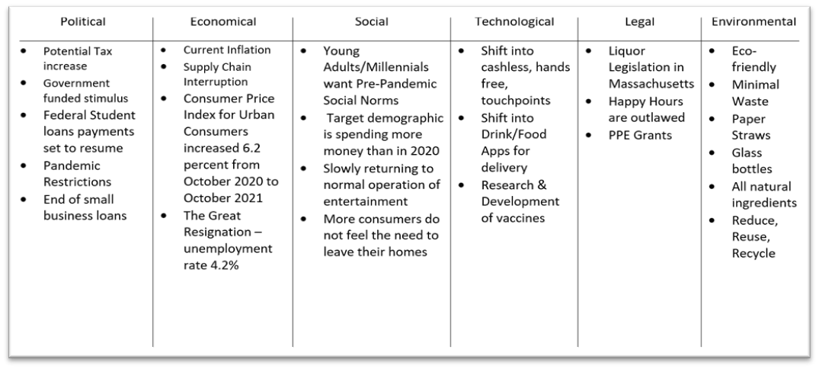
Marketing Management - SWOT Analysis

Slide 5
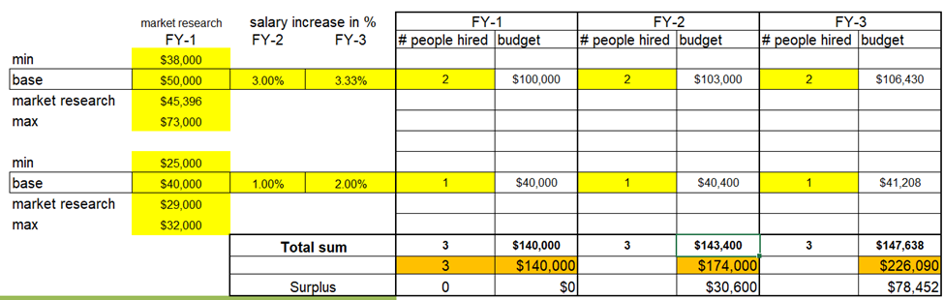
Organizational and HR management analysis
Average Salary for experienced Brewmaster - $50,000
Average Salary for Bar Manager - $40,000
Brewmaster Merit Increase: 3% in FY2, 3.3% FY3
Bar/Associate Manager Merit Increase: 1% in FY2, 2% in FY3
Total Expense:
FY1: $140,000
FY2: $174,000
FY3: $226,090
Variance Analysis - Better/(Worse) vs Prior Year:
FY2 vs FY1: ($30,600)
FY2 vs FY3: ($78,852)

Slide 6
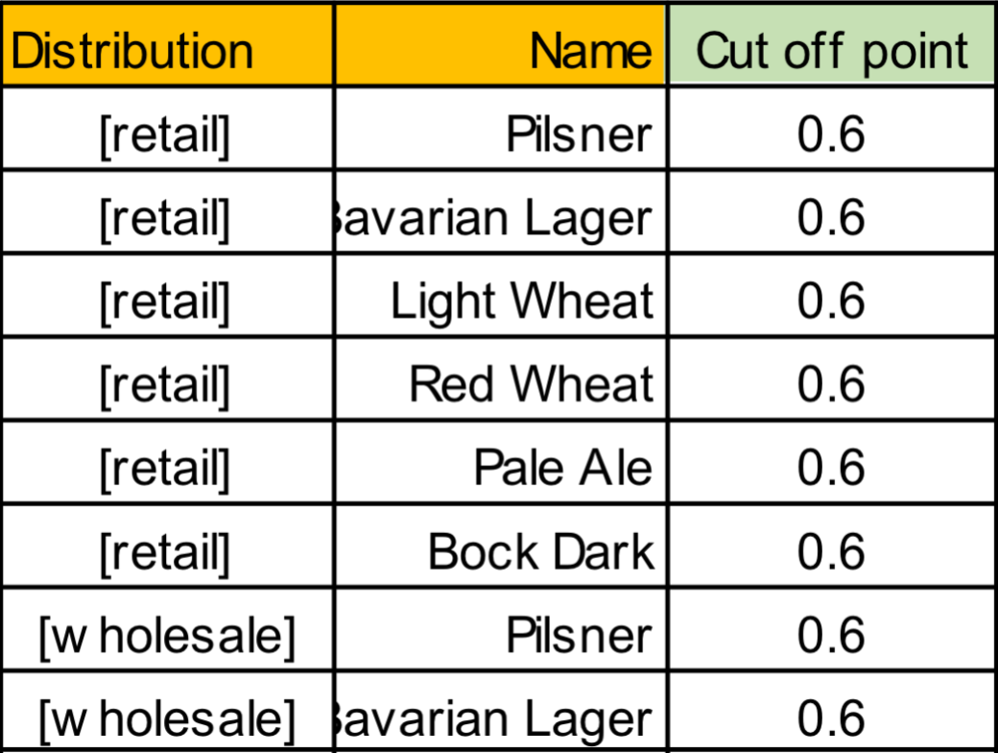
Operations Management
The default value of the cut-off point was 0.8. If the demand equals or exceeds 80%, beer will continue to be produced until it reaches the maximum. Conversely, if the market demand is lower than the cut-off point of the tank, production will stop.
Operational management is the management of business practices to create the highest level of efficiency within the organization. It focuses on converting materials and labor into goods and services as efficiently as possible to maximize the profitability of the organization. Therefore, operation management is very important because it determines productivity.
Default cut-off Point of each beer product
E.g. for the first product Pilsner, the demand value in the first year is 19857.9, and its Cut-off Point set to 0.8, namely when the demand is below 15886, it will not be produced.

Slide 7
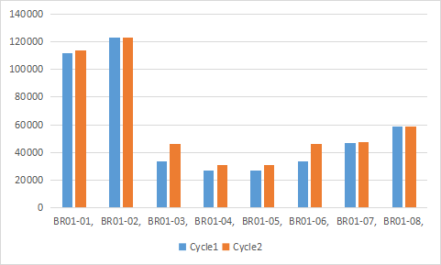
Operation Management Analysis
Sensitivity Analysis
The contribution of each product in Cycle2 is obviously higher than that of Cycle1, such as BR01-03 (Light Wheat), which has changed from $33,817 to $45,900 , a difference of $12083, profit before taxes rose from $242,605 in Cycle 1 to $281,032, and projected consumption rose from 237,272 to 252,876.
Optimization Analysis
Cut-off Point of each beer product in Cycle2
Optimization Analysis shows that the contribution of BR01-01 (Pilsner) has increased from $111,960.16 in Cycle 1 to $114,112.23, the contribution of BR01-02 (Bavarian Lager) has not changed, and so on. More changes are shown in Figure 3.2. The overall change is that the Projected Consumption has been increased from 237272 to 252876, and the Profit before Taxes has been increased from $464,496 to $502,923. The increase in revenue is quite obvious.
Contribution of Cycle1 and Cycle2 by Optimization Analysis

Slide 8
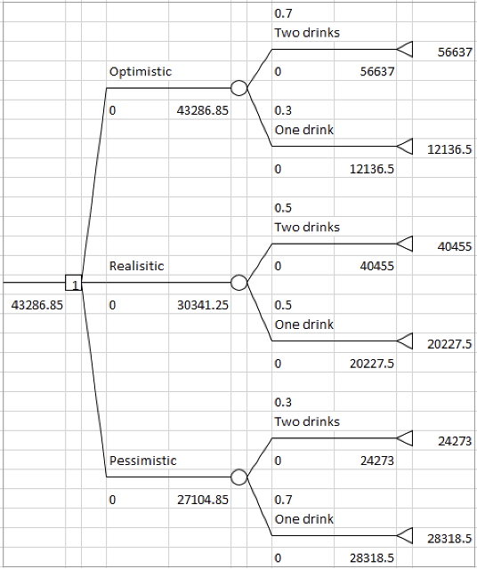
Financial Management analysis
Decision-tree analysis:
Offer’s investment: 150,000.00 USD Covers 1st year ingredients and maintenance fee
Expected Monthly revenue is 43,286.85 USD
CAPEX: 66,400.00 USD
Brew tanks Renovation
OPEX per month: 30,612.00 USD
Rent and utilities Salary and benefits Ingredients
Projected monthly finance:
$40,455 USD - $56,637 USD
Monthly average 4500 beer drinkers
Consume 1-2 pints per seatings
Weekly meetings
=> BEP at 5.78 - 15.23.
Further consideration:
Cut-off point: 0.7 - 0.8
Opex changes: $27,450 - $29,037
=> BEP with consideration to cutoff: 11.53 - 12.49

Slide 9
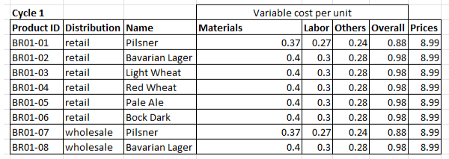
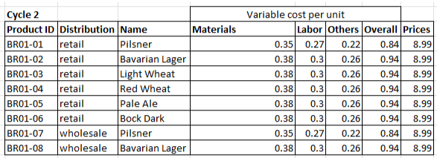
Innovation and Research management analysis
Process Improvements: Evaluate process improvements to reduce costs i.e. (i) recycle waste water leading to reduction in purchasing cost of purified water and (ii) PET packaging leading to reduction in overall packaging and cost of replacement of beer cups
Starting Assumptions: (i) sale price per unit retained i.e. $8.99 (ii) total variable cost at $0.88 for pilsner whereas $0.98 for rest of the products (iii) innovative technology will lead to reduction of materials and other cost
Results: (i) material and other cost reduction by $0.02 (ii) labor costs unchanged (iii) equipment expenses - $10,000 (domestic treatment plant), $1000 to make it ready, maintenance, etc. (iii) reduction in the variable costs, increase in expenses but overall the operating parameters of investing in microbrewery are unchanged

Slide 10
Output evaluation and KPIs
Marketing
Customer convert Customer demographic
Operation
Production quantities Cut-off production
Innovation
New brews Efficiency improvement
Finance
Monthly revenue Monthly waste Monthly consumers
Organization
Effective evaluation Productivity Average salary

Slide 11
Overall strategy & Implementation plan (6-months)
Continue marketing
Optimize and fine tune brewing process
Perform analysis support on all management
Marketing trend recap
Innovate blend
Review innovation
Preparation into expansion
Month 1
Month 2
Month 3
Month 4
Month 5
Month 6
Renovation of location
Install tanks & utilities
Depositing ingredients
Begin marketing
Begin brewing (week 2)
Begin reviewing KPI performance:
Monthly Finance
Marketing efficient
Worker evaluation
Productional cut-off
New brew and process efficiency
Review KPI
Considering into expansion of delivery method
Reconsider worker force
Research for expansion

Slide 12
Questions
&
Answers
Bud Jaegar
Drink your way, charge our way
Thank you for your attention

